Slide 1

Spring
6
Word Relationships and Statistics
Stuy Prep
Lesson 26S6
Notes:
Slide designed by Benjamin Xie. Logo designed by Madeleine Villamil.

Slide 2
Welcome
Questions on Homework 5?
If not, here’s an icebreaker:
26S5 Homework
Would you rather have a goose that blocks you from leaving any conversation until it decides you’re done or a horse that stares intently at you all night?
₊✩‧₊˚౨ৎ˚₊✩‧₊ ✮ ⋆ ˚｡⋆｡°✩⋆˚˖°
Notes:
Slide designed by Benjamin Xie. Logo designed by Madeleine Villamil.

Slide 3
metaphor sarcastic parallelism
Spring
6
English Language Arts
Word Relationships
Aim: Identify and analyze figurative language, figurative speech, connotations, and tone.
Do Now: What are some types of figurative language?
hyperbole cynical repetition
Notes:
→ hyperbole, metaphor, simile, personification
Slide designed by Amy Shrestha & Benjamin Xie. Logo designed by Madeleine Villamil.

Slide 4
Figurative Language
Figurative language is the use of words or phrases that deviate from their literal, dictionary definition to create a more vivid, impactful, or imaginative description
There are 4 key types:
Simile
Metaphor
Personification
Hyperbole
hyperbole cynical repetition
Notes:
Slide designed by Amy Shrestha & Benjamin Xie. Logo designed by Madeleine Villamil.

Slide 5
Figurative Language
Similes are a figure of speech that directly compares two different things to create a vivid image using the words “like” or “as.”
Common formats:
As [adjective] as [noun]
[verb] like [noun]
Literature/Idioms
hyperbole cynical repetition
Notes:
Slide designed by Amy Shrestha & Benjamin Xie. Logo designed by Madeleine Villamil.

Slide 6
Figurative Language
Similes are a figure of speech that directly compares two different things to create a vivid image using the words “like” or “as.”
Common formats:
As light as a feather
sleeps like a log
Life is like a box of chocolates
hyperbole cynical repetition
Notes:
Slide designed by Amy Shrestha & Benjamin Xie. Logo designed by Madeleine Villamil.

Slide 7
Figurative Language
Metaphors are a figure of speech that directly compares two different things to create a vivid image WITHOUT using the words “like” or “as.”
Common formats:
He has a heart made out of stone (he is cold)
All the world’s a stage (implies life is a performance)
hyperbole cynical repetition
Notes:
Slide designed by Amy Shrestha & Benjamin Xie. Logo designed by Madeleine Villamil.

Slide 8
Figurative Language
Hyperboles are intentional, extreme exaggerations used as a figure of speech to emphasize a point, evoke strong feelings, or create humor.
Common formats:
I'm so hungry I could eat a horse
That suitcase weighs a ton
This coffee is out of this world!
hyperbole cynical repetition
Notes:
Slide designed by Sabrina Gao & Benjamin Xie. Logo designed by Madeleine Villamil.

Slide 9
Figurative Language
Personification is a figure of speech used to give non-human objects human qualities, emotions, or actions.
Common formats:
The stubborn door refused to open
My plants are begging for water
The plants danced in the respite of the wind
hyperbole cynical repetition
Notes:
Slide designed by Amy Shrestha & Benjamin Xie. Logo designed by Madeleine Villamil.

Slide 10
Connotations
Connotations are the emotional, cultural, or implied meanings associated with a word, in addition to its literal dictionary definition (denotation).
POSITIVE connotations:
evoke pleasant or admirable feelings
e.g., childlike, determined, unique, aroma
hyperbole cynical repetition
Notes:
Slide designed by Sabrina Gao, Amy Shrestha & Benjamin Xie. Logo designed by Madeleine Villamil.

Slide 11
Connotations
Connotations are the emotional, cultural, or implied meanings associated with a word, in addition to its literal dictionary definition (denotation).
NEGATIVE connotations:
evokes unpleasant, unfavorable, or emotional feelings
e.g., childish, stubborn, weird, stench
hyperbole cynical repetition
Notes:
Slide designed by Sabrina Gao, Amy Shrestha & Benjamin Xie. Logo designed by Madeleine Villamil.

Slide 12
Connotations
Connotations are the emotional, cultural, or implied meanings associated with a word, in addition to its literal dictionary definition (denotation).
NEUTRAL Connotations:
have no specific emotional association
e.g., strong-willed, scent, house
hyperbole cynical repetition
Notes:
Slide designed by Sabrina Gao, Amy Shrestha & Benjamin Xie. Logo designed by Madeleine Villamil.

Slide 13
Related Words
Words can be connected by grouping them into specific categories, functions, or by their root words.
By grouping words by their connotations, patterns, and shared meanings, it helps you answer vocabulary in context questions. It’s like playing the game of odd one out!
hyperbole cynical repetition
Notes:
Slide designed by Amy Shrestha & Benjamin Xie. Logo designed by Madeleine Villamil.

Slide 14
Related Words
For example, the words “apple,” “banana,” and “grape” are all fruits, and are grouped by category. “Pen,” “marker,” and “pencil” are grouped by their function as writing tools.
Words like biology, biography, antibiotic, and symbiosis all contain the root word “bio,” which means life.
hyperbole cynical repetition
Notes:
Slide designed by Amy Shrestha & Benjamin Xie. Logo designed by Madeleine Villamil.

Slide 15
Tone
Tone is an attitude such as sad, humorous, etc. that the author tries to convey using specific words. Try identifying the tone as you read the passage.
For example, if the author uses words such as “delightful”, “joy”, the tone is happy. If you see words such as “terror”, “dread”, the tone is fearful.
hyperbole cynical repetition
Notes:
Slide designed by Amy Shrestha & Benjamin Xie. Logo designed by Madeleine Villamil.

Slide 16
Tone
Look for strong language/keywords.
Pay attention to sentence structure.
Use process of elimination.
Identify figurative language.
To answer questions that ask about the author’s tone:
hyperbole cynical repetition
Notes:
Slide designed by Amy Shrestha & Benjamin Xie. Logo designed by Madeleine Villamil.

Slide 17
Tone
Some major answer traps to look out for in these questions are:
Too extreme: The answer twists the tone used in the passage and changes the tone from what it was in the passage.
hyperbole cynical repetition
Notes:
Slide designed by Amy Shrestha & Benjamin Xie. Logo designed by Madeleine Villamil.

Slide 18
Tone
Some major answer traps to look out for in these questions are:
2) Out of scope: The answer
either shows the wrong
emotion at the right intensity, or the right emotion at the wrong intensity.
hyperbole cynical repetition
Notes:
Slide designed by Amy Shrestha & Benjamin Xie. Logo designed by Madeleine Villamil.

Slide 19
Tone
Many believed the invention would revolutionize communication. Yet, after years of testing, it remained clunky and unreliable. While the original vision was grand, the outcome fell far short of expectations.
What is the author’s tone toward the artist’s early work?
A) Optimistic B) Sarcastic C) Disappointed D) Neutral
hyperbole cynical repetition
Notes:
Slide designed by Amy Shrestha.

Slide 20
Tone
Many believed the invention would revolutionize communication. Yet, after years of testing, it remained clunky and unreliable. While the original vision was grand, the outcome fell far short of expectations.
What is the author’s tone toward the artist’s early work?
A) Optimistic B) Sarcastic C) Disappointed D) Neutral
hyperbole cynical repetition
Notes:
Slide designed by Amy Shrestha.

Slide 21
Tone
Some keywords to keep in mind (they often appear on the SHSAT):
If the passage sounds… then the tone is…
ironic: sarcastic/cynical
balanced pros and cons: reflective
doubt/suspicion: skeptical
mockery with humor: sarcastic
negative but emotional: frustrated/disappointed
hyperbole cynical repetition
Notes:
Slide designed by Amy Shrestha & Benjamin Xie. Logo designed by Madeleine Villamil.

Slide 22
mean mode average range
Spring
6
Mathematics
Statistics
Aim: Analyze measures of center and variation in quantitative data visualizations.
Do Now: What types of statistical graphs are there?
interquartile range standard deviation
Notes:
Histogram, dot plot, scatterplot, etc.
Slide designed by Benjamin Xie.

Slide 23
Understanding Statistics
Statistics is the field of math that summarizes populations.
When you ask a statistical question, you expect variability in the answer.
For example, “How tall am I?” only has one answer, but “How tall are my classmates?” has multiple different answers.
interquartile range standard deviation
Notes:
Standard approximation: NY-6.SP.1
Slide designed by Benjamin Xie. Logo designed by Madeleine Villamil.

Slide 24
Understanding Statistics
It collects quantitative data (numerical, not descriptive) from a representative sample.
A representative sample should represent all parts of the population—a range of genders, ages, races, etc.
interquartile range standard deviation
Notes:
Standard approximation: NY-6.SP.1
Slide designed by Benjamin Xie. Logo designed by Madeleine Villamil.

Slide 25
Understanding Statistics
The easiest way to get a representative sample is to sample randomly.
You want to avoid sampling bias by, for example, using an online poll when not everyone in the population has online access.
The larger a sample is, the more representative it is, but also the harder it gets to actually measure it.
You can’t possibly ask all 300 million U.S. residents, but you can ask a sample of 3,000.
interquartile range standard deviation
Notes:
Standard approximation: NY-6.SP.1
Slide designed by Benjamin Xie. Logo designed by Madeleine Villamil.

Slide 26
Displaying Quantitative Data
Quantitative data can be displayed in many ways, usually using a number line:
Dot plots show each point for small samples.
Histograms show shape by grouping into bins.
1
2
3
4
5
6
7
8
6
4
2
0
10
20
30
interquartile range standard deviation
Notes:
Standard approximation: NY-6.SP.2, NY-6.SP.4
Slide designed by Benjamin Xie. Logo designed by Madeleine Villamil.

Slide 27
Displaying Quantitative Data
Histograms are not bar graphs!
6
6
4
4
2
2
0
10
20
30
Apples
Oranges
Bananas
interquartile range standard deviation
Notes:
Standard approximation: NY-6.SP.2, NY-6.SP.4
Slide designed by Benjamin Xie. Logo designed by Madeleine Villamil.

Slide 28
Displaying Quantitative Data
Box plots show quartiles and outliers (more on those later).
Line graphs show change over time.
1
2
3
4
5
6
7
8
6
4
2
Jan
Feb
Mar
Apr
May
Jun
Jul
interquartile range standard deviation
Notes:
Standard approximation: NY-6.SP.2, NY-6.SP.4
Slide designed by Benjamin Xie. Logo designed by Madeleine Villamil.

Slide 29
Measures of Center
Measures of center, also known as the central tendency, are statistics identify the center point of a data set.
The most common include:
mean: average of the data points
mode: value that appears most frequently
median: the exact middle value when data is ordered ascendingly
interquartile range standard deviation
Notes:
Slide designed by Amy Shrestha. Logo designed by Madeleine Villamil.

Slide 30
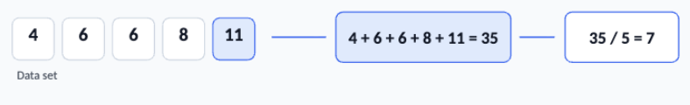
Mean
Question it answers: If everyone shared equally, how much would each person get?
Formula:
mean = total sum of all values / number of values
interquartile range standard deviation
Notes:
Slide designed by Amy Shrestha. Logo designed by Madeleine Villamil.

Slide 31
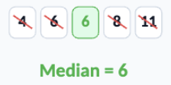
Median
Question it answers: What value is in the exact middle of the ordered list?
Step 1: put the data in increasing order.
Step 2: Cross off from both ends until the middle remains
If there’s an even number of values, then average the two middle numbers!
interquartile range standard deviation
Notes:
Slide designed by Amy Shrestha. Logo designed by Madeleine Villamil.

Slide 32

Mode
Question it answers: Which value occurs more often than the others?
Make a list that counts the number of times each unique value appears.
It is possible to have MORE than one mode or NONE!
interquartile range standard deviation
Notes:
Slide designed by Amy Shrestha. Logo designed by Madeleine Villamil.

Slide 33
Mean, Median, Mode
If you surveyed 7 people about their heights (in) and you get this set of values:
54, 60, 60, 58, 55, 64, 62
What is the…
a) mean b) median c) mode?
Remember:
mean = total sum of values / number of values
interquartile range standard deviation
Notes:
Slide designed by Amy Shrestha. Logo designed by Madeleine Villamil.

Slide 34
Mean, Median, Mode
If you surveyed 7 people about their heights (in) and you get this set of values:
54, 60, 60, 58, 55, 64, 62
What is the…
a) mean b) median c) mode?
total = 54 + 60 + 60 + 58 + 55 + 64 + 62 = 413
number of values = 7
mean = 413/7 = 59
This tells us the average height in the group of people we surveyed is 59 inches.
interquartile range standard deviation
Notes:
Slide designed by Amy Shrestha. Logo designed by Madeleine Villamil.

Slide 35
Mean, Median, Mode
If you surveyed 7 people about their heights (in) and you get this set of values:
54, 60, 60, 58, 55, 64, 62
What is the…
a) mean b) median c) mode?
To find the median, sort the list in ascending order:
54, 55, 58, 60, 60, 62, 64
54, 55, 58, 60, 60, 62, 64
54, 55, 58, 60, 60, 62, 64
54, 55, 58, 60, 60, 62, 64
interquartile range standard deviation
Notes:
Slide designed by Amy Shrestha. Logo designed by Madeleine Villamil.

Slide 36
Mean, Median, Mode
If you surveyed 7 people about their heights (in) and you get this set of values:
54, 60, 60, 58, 55, 64, 62
What is the…
a) mean b) median c) mode?
The number that appears most often is the mode:
54: 1 time
55: 1 time
58: 1 time
60: 2 times
62: 1 time
64: 1 time
interquartile range standard deviation
Notes:
Slide designed by Amy Shrestha. Logo designed by Madeleine Villamil.

Slide 37
Measures of Variation
Measures of variation, also known as the spread, are statistics define how spread out or clustered data is around the center.
The most common include:
range: difference between maximum and minimum values in a data set
interquartile range standard deviation
Notes:
Slide designed by Benjamin Xie & Amy S. Logo designed by Madeleine Villamil.

Slide 38
Measures of Variation
Measures of variation, also known as the spread, are statistics define how spread out or clustered data is around the center.
interquartile range (IQR): difference between the third quartile and the first quartile (measures spread of middle 50% of data)
interquartile range standard deviation
Notes:
Slide designed by Benjamin Xie & Amy S. Logo designed by Madeleine Villamil.

Slide 39
Measures of Variation
In the box plot below, the box represents the interquartile range.
1
2
3
4
5
6
7
8
interquartile range standard deviation
Notes:
Slide designed by Benjamin Xie & Amy S. Logo designed by Madeleine Villamil.

Slide 40
Measures of Variation
Measures of variation, also known as the spread, are statistics define how spread out or clustered data is around the center.
mean absolute deviation (MAD): measures how spread out the data is from the mean (average)
small MAD: consistent data
larger MAD: varied data
interquartile range standard deviation
Notes:
Slide designed by Benjamin Xie & Amy S. Logo designed by Madeleine Villamil.

Slide 41
Measures of Variation
The top data set has a larger MAD, while the second data set has a smaller MAD, as shown by the distance from the average (the red triangle).
1
2
3
4
5
6
7
8
1
2
3
4
5
6
7
8
interquartile range standard deviation
Notes:
Slide designed by Benjamin Xie & Amy S. Logo designed by Madeleine Villamil.

Slide 42
Measures of Variation
If you surveyed 7 people about their heights (in) and you get this set of values:
54, 60, 60, 58, 55, 64, 62
What is the mean average deviation (MAD)?
mean = 59
Find distances from data point to mean.
|54 − 59| = 5
|60 − 59| = 1
|60 − 59| = 1
|58 − 59| = 1
|55 − 59| = 4
|64 − 59| = 5
|62 − 59| = 3
interquartile range standard deviation
Notes:
Slide designed by Amy Shrestha. Logo designed by Madeleine Villamil.

Slide 43
Measures of Variation
If you surveyed 7 people about their heights (in) and you get this set of values:
54, 60, 60, 58, 55, 64, 62
What is the mean average deviation (MAD)?
Find the mean of those distances:
total sum = 5 + 1 + 1 + 1 + 4 + 5 + 3 = 20
MAD = 20/7 ≈ 2.86
On average, each person’s height is about 2.86 inches away from the mean height.
interquartile range standard deviation
Notes:
Slide designed by Amy Shrestha. Logo designed by Madeleine Villamil.

Slide 44
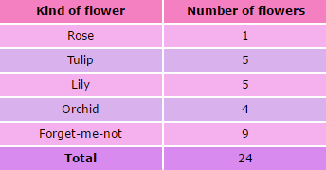
Reading Tables
Tables displays data in organized rows and columns. By using tables, it’s easy to look up exact values or compare multiple variables.
interquartile range standard deviation
Notes:
Slide designed by Amy Shrestha. Logo designed by Madeleine Villamil.

Slide 45
Reading Tables
Some questions they might ask on the SHSAT:
How many more people liked orchids than roses?
What fraction of the people surveyed liked forget-me-nots best?
interquartile range standard deviation
Notes:
Slide designed by Amy Shrestha. Logo designed by Madeleine Villamil.

Slide 46
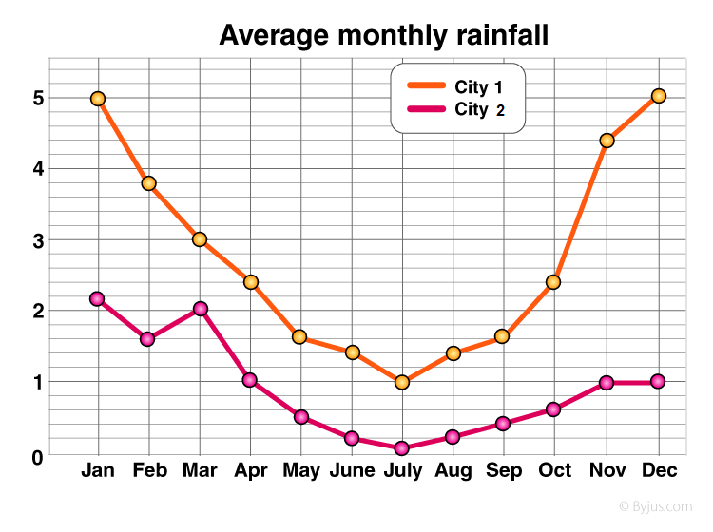
Reading Line Graphs
Here, a line graph is used to track the average monthly rainfall (in inches) over the span of a year.
Never miss sharp changes in line graphs!
interquartile range standard deviation
Notes:
Slide designed by Amy Shrestha. Logo designed by Madeleine Villamil.

Slide 47
Reading Line Graphs
How many inches of rain did City 1 get in July? November?
How many more inches of rain did City 1 than City 2 get in December?
interquartile range standard deviation
Notes:
Slide designed by Amy Shrestha. Logo designed by Madeleine Villamil.

Slide 48
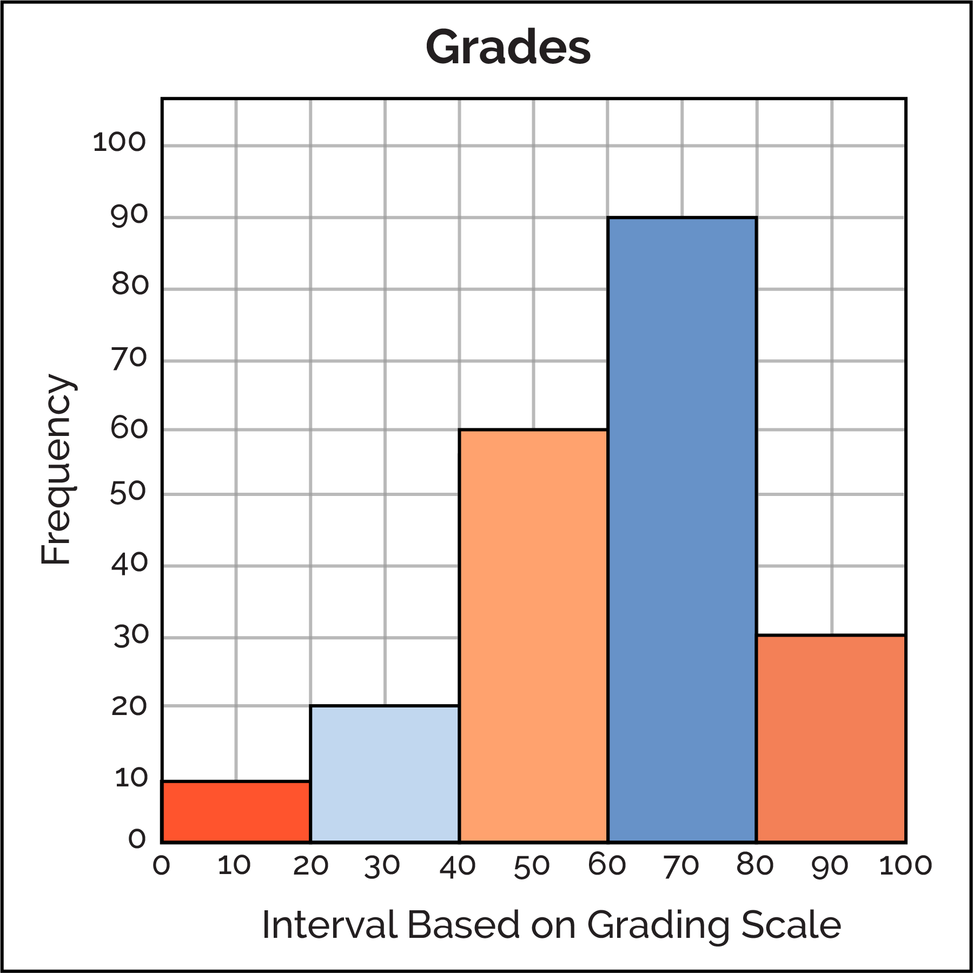
Reading Histograms
Remember that histograms use intervals to denote values! Don’t confuse them with bar graphs.
For example, we are given the frequency of values for the grade intervals 0-20, 20-40, 40-60, etc.
interquartile range standard deviation
Notes:
Slide designed by Amy Shrestha. Logo designed by Madeleine Villamil.

Slide 49
Reading Histograms
How many more students scored in the 80-100 range than the 0-40 range?
Which range has the most values?
How many students took the test?
interquartile range standard deviation
Notes:
Slide designed by Amy Shrestha. Logo designed by Madeleine Villamil.

Slide 50
Spring
6
Thanks for coming! Questions?
Remember to come back after the 10-minute break!
Notes:
Slide designed by Benjamin Xie. Logo designed by Madeleine Villamil.

